Slide 1
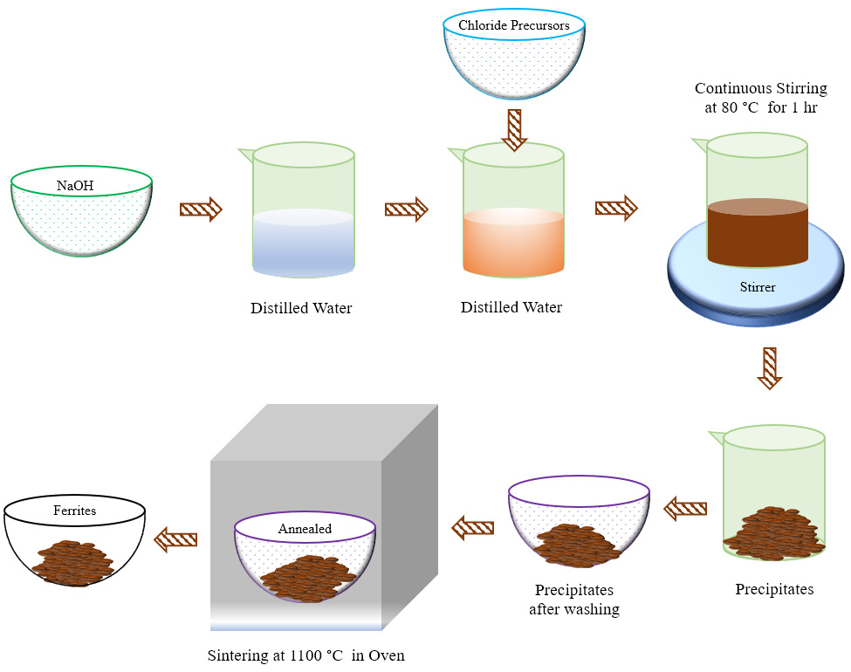
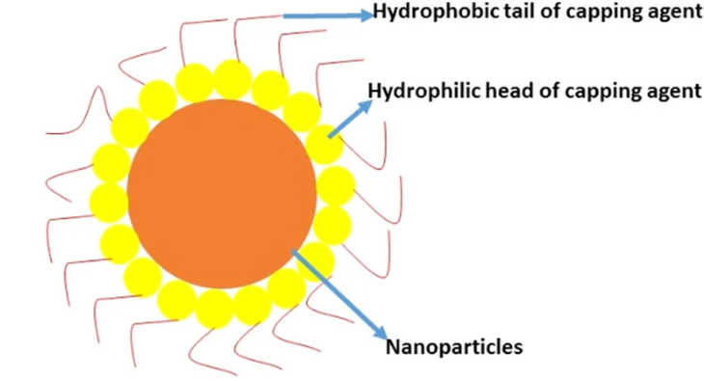
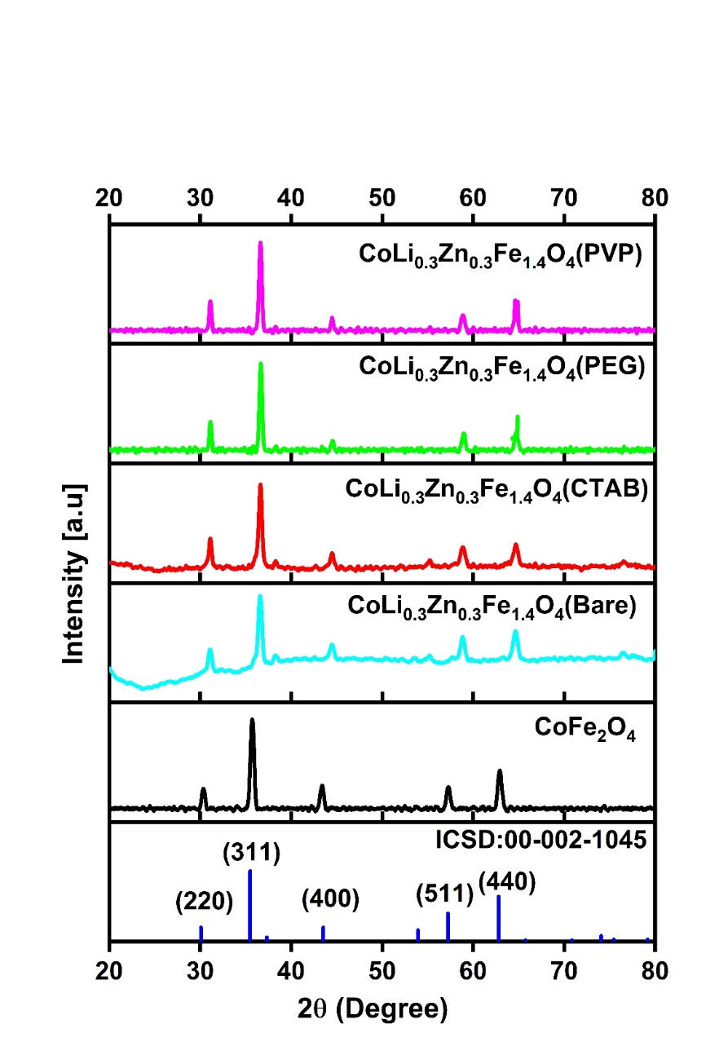
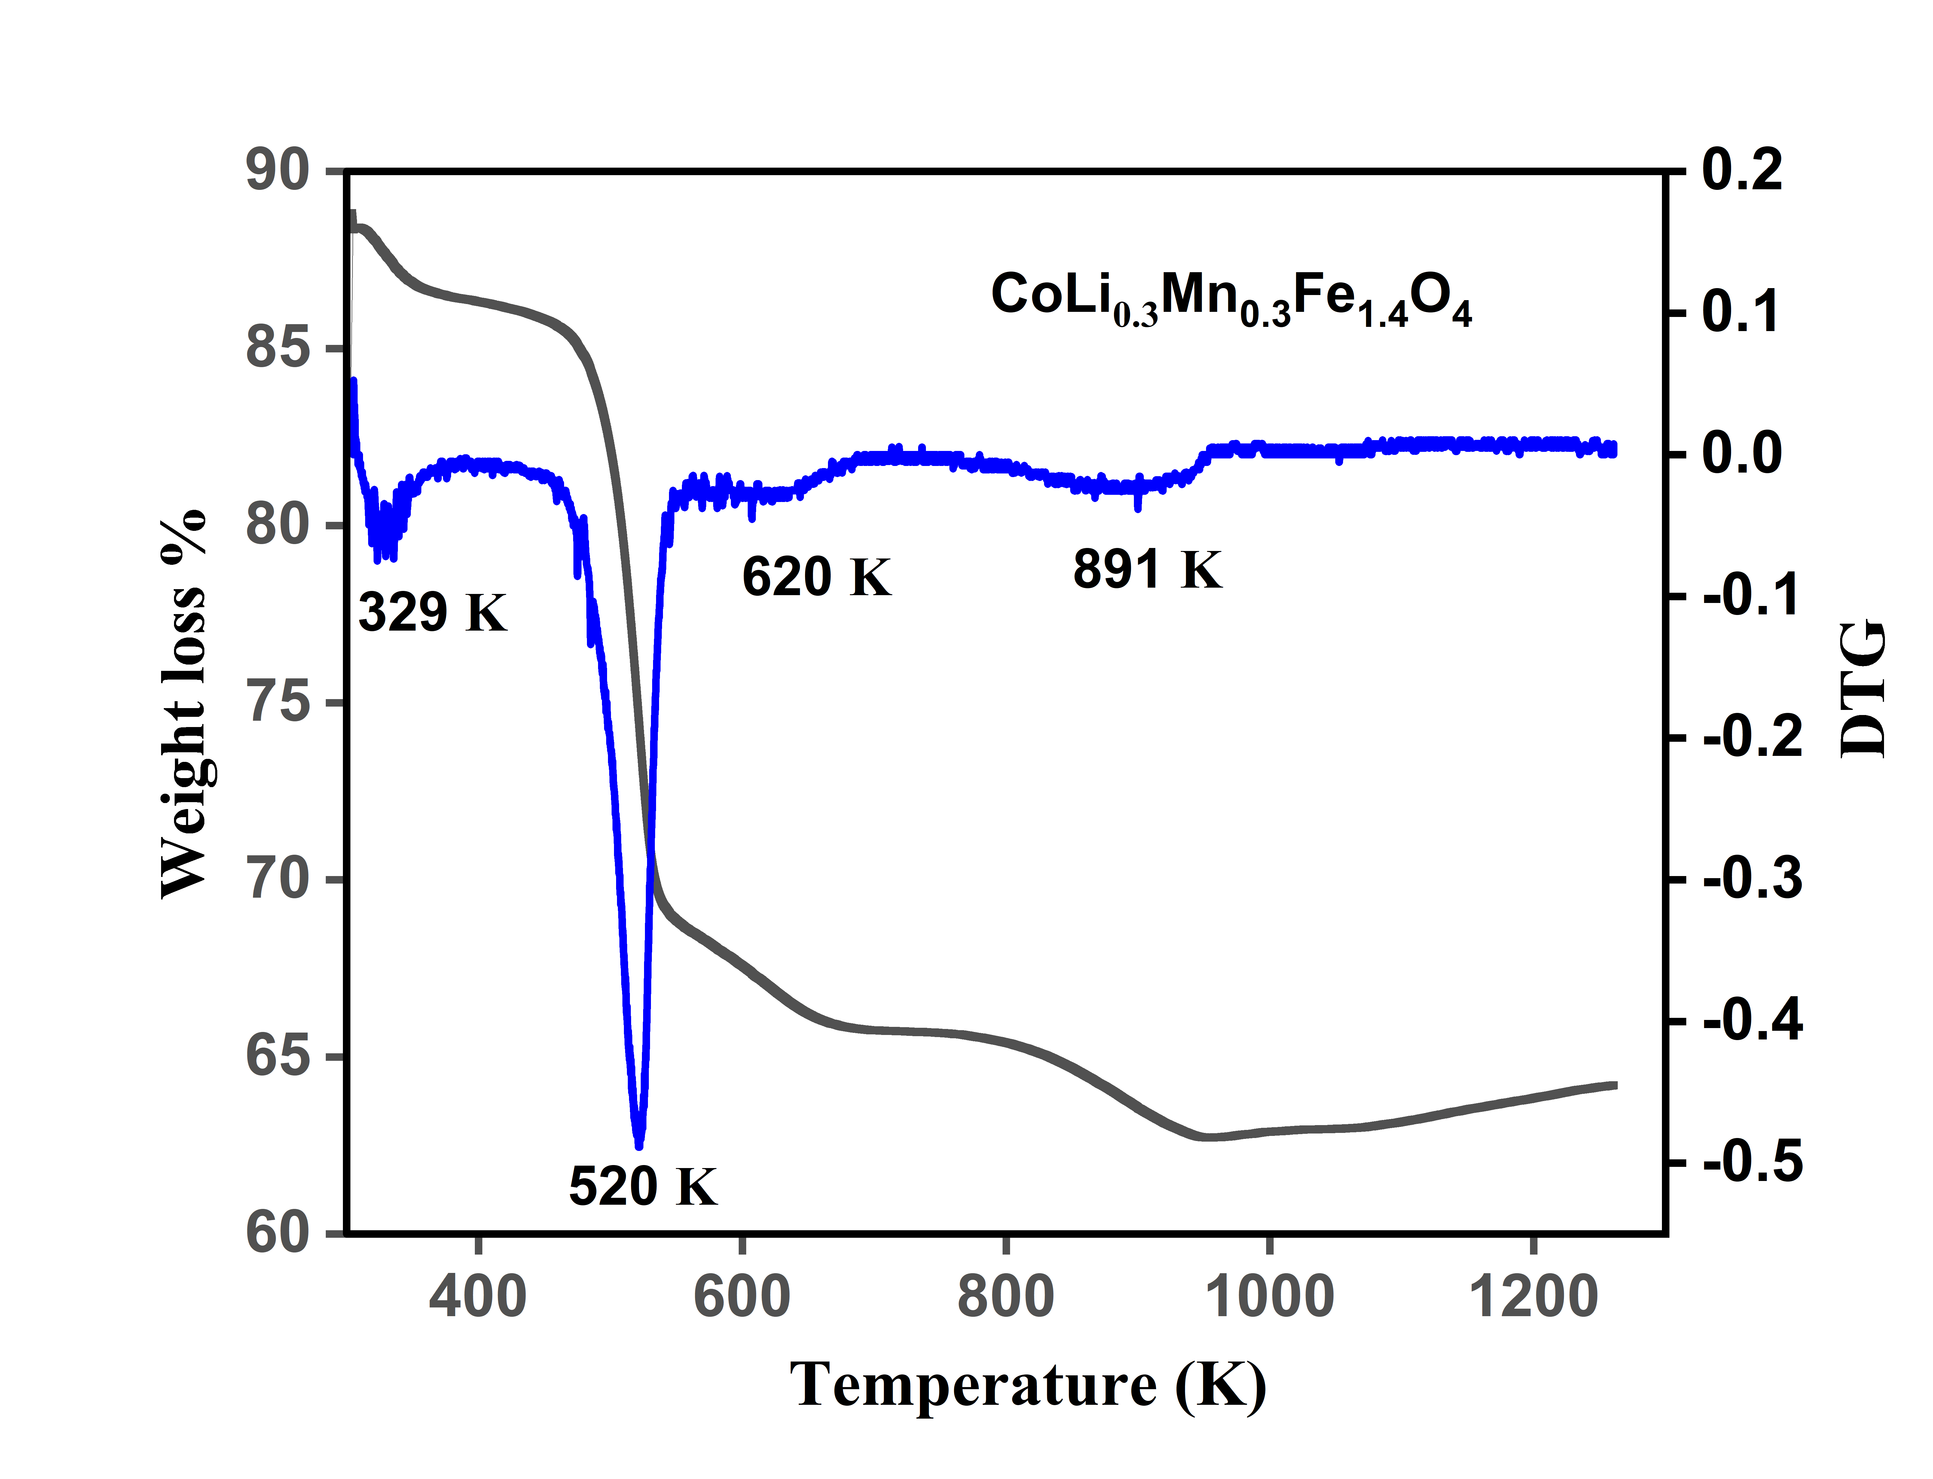
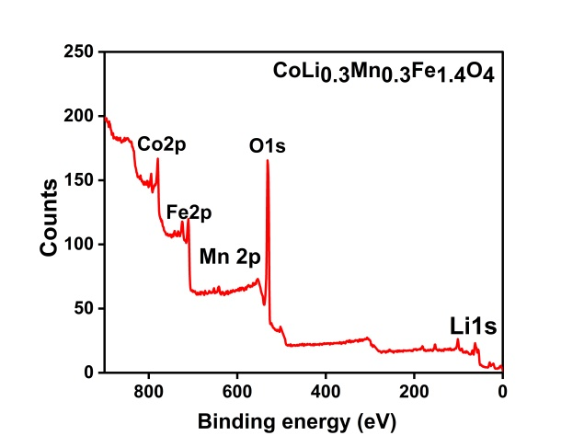
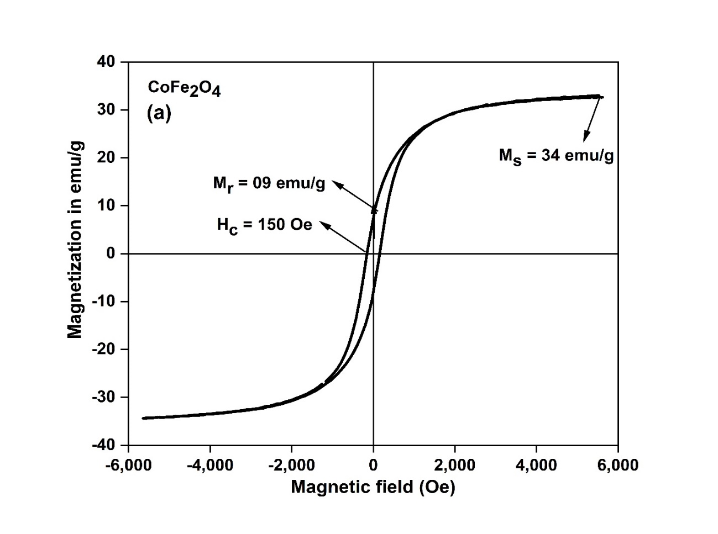
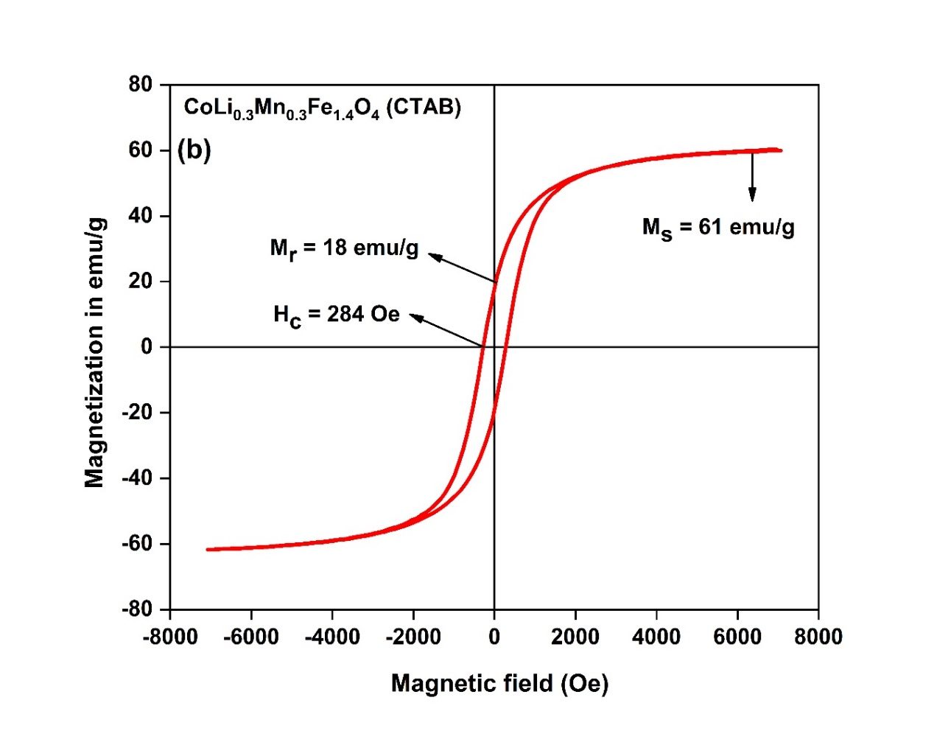
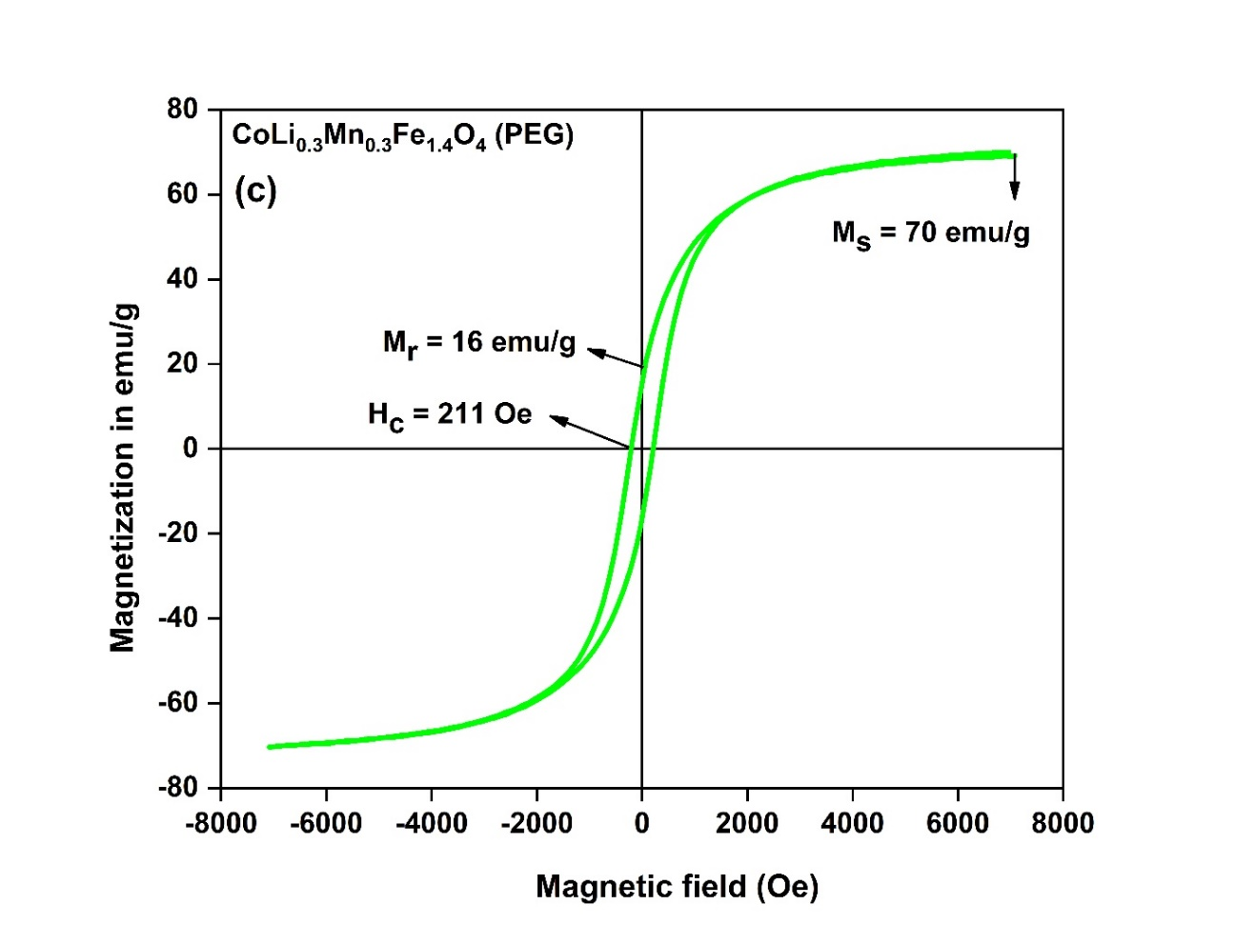
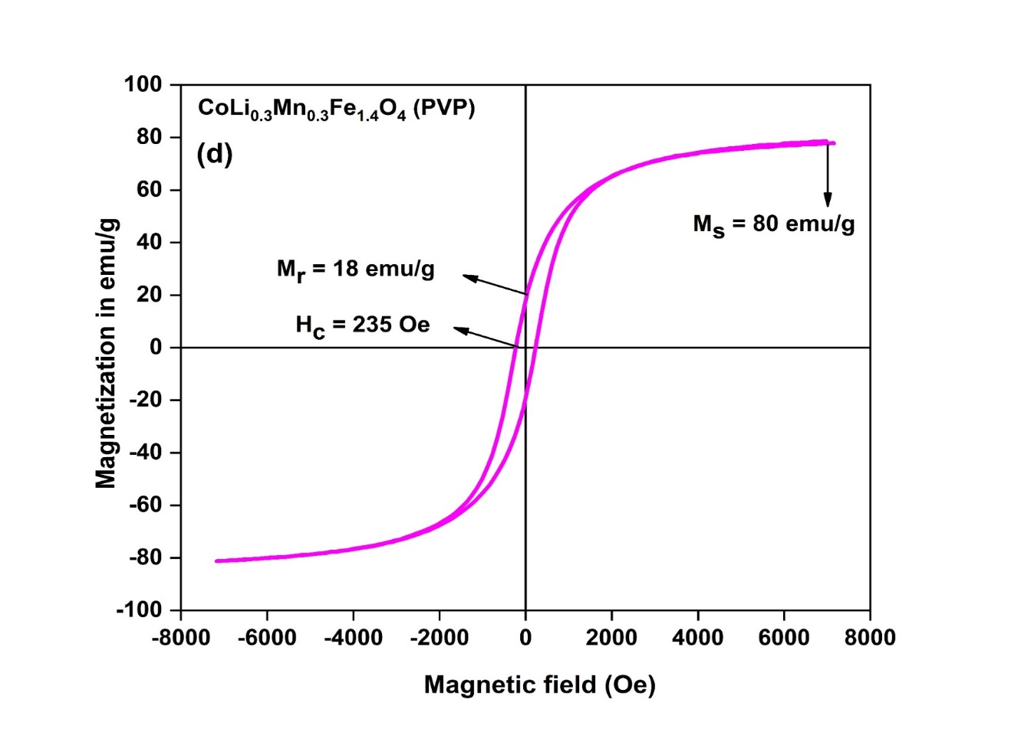
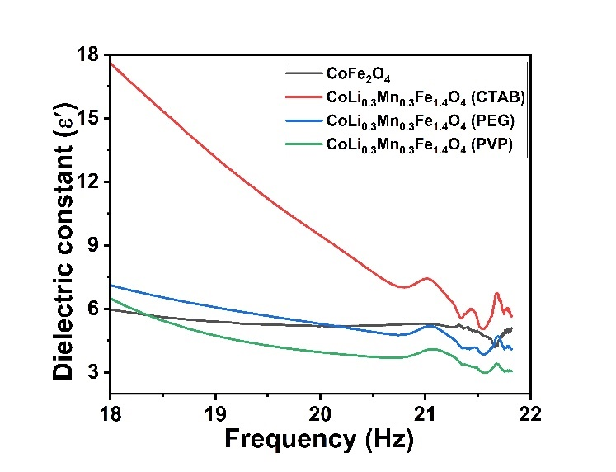
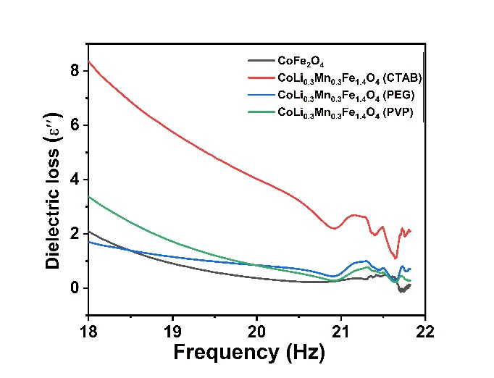
Synthesis and Characterization of CoLi_{0.3}Mn_{0.3}Fe_{1.4}O₄ Ferrite Nanoparticles with Improved Saturation Magnetization Using Surfactant-Assisted Co-Precipitation
Mahwish Afzia ⃰ , Rafaqat Ali Khan
Department of Chemistry, COMSATS Institute of Information Technology, Abbottabad Pakistan
Abstract
In our study, bare cobalt ferrite and Li⁺-Mn²⁺ co-doped cobalt ferrite nanoparticles (CoLi_{0.3}Mn_{0.3}Fe_{1.4}O₄) were synthesized using a co-precipitation approach both without surfactants and in the presence of three different surfactants, including cetyltrimethyl ammonium bromide (CTAB), polyvinyl pyrrolidone (PVP), and polyethylene glycol (PEG). The influence of various surfactants on the formation of crystal structure, morphology, magnetic and dielectric properties was investigated through X-ray diffraction (XRD), Scanning electron microscopy (SEM), vibrating sample magnetometer (VSM), and dielectric measurements. The XRD findings revealed the pure crystalline nature of synthesized samples with no impurity. The SEM micrographs revealed that sample coated with PVP is more uniform. The Energy Dispersive X-ray (EDX) analysis confirmed that the elemental composition was relevant with the expected values for the co-precipitation route.
. The presence of surfactants reduces the size of ferrite nanoparticles, leading to decreased coercivity and a significant enhancement in saturation magnetization, making it a suitable candidate for various applications. The dielectric loss of the synthesized nanoparticles significantly decreased, making the material suitable for high-frequency applications. The current findings indicate that the addition of various surfactants during sample preparation significantly controls the size of CoLi_{0.3}Mn_{0.3}Fe_{1.4}O₄ nanoparticles, which in turn has a noticeable impact on the magnetic properties of the materials.
Introduction
Structure of surfactants
Synthesis Route
Structure of PEG
Structure of CTAB
Structure of PEG
Nanoparticles covalently bound with capping agents
RESULTS
X-Ray Diffraction Analysis (XRD)
Thermo gravimetric Analysis (TGA)
X-Ray Photoelectron Spectroscopy (XPS)
CoLi_{0.3}Mn_{0.3}Fe_{1.6}O₄ (PVP)
CoLi_{0.3}Mn_{0.3}Fe_{1.6}O₄ (PEG)
CoLi_{0.3}Mn_{0.3}Fe_{1.6}O₄ (CTAB)
CoLi_{0.3}Mn_{0.3}Fe_{1.6}O₄ (Bare)
CoFe₂O₄
Scanning Electron Micrographs (SEM)
Vibrating Sample Magnetometer (VSM)
CoFe₂O₄
CoLi_{0.3}Mn_{0.3}Fe_{1.6}O₄ (Bare)
CoLi_{0.3}Mn_{0.3}Fe_{1.6}O₄ (CTAB)
CoLi_{0.3}Mn_{0.3}Fe_{1.6}O₄ (PEG)
CoLi_{0.3}Mn_{0.3}Fe_{1.6}O₄ (PVP)
Dielectric Measurements
Conclusion
Li⁺-Mn²⁺ codoped cobalt ferrite with three different surfactants are synthesized from co-precipitation route.
The phase purity is confirmed from XRD analysis.
From SEM micrographs, it is found that more homogeneity is observed in case of sample coated with PVP.
Maximum saturation magnetization is observed in case of sample coated with PVP.
Minimum values of dielectric measurements is observed.
References
Acknowledgment
More, S., et al., Cation distribution in nanocrystalline Al3+ and Cr3+ co-substituted CoFe2O4. Journal of alloys and compounds, 2010. 502(2): p. 477-479.
Duvuru, H.B., et al., Magnetic and dielectric properties of Zn substituted cobalt oxide nanoparticles. Ceramics International, 2019. 45(13): p. 16512-16520.
We are thankful to COMSATS Abbottabad for facilitating us in compilation of this project.

